Slide 1
Alternating Current

Slide 2


Slide 3


Slide 4

To properly analyse an AC circuit, we need some way to take the average current and voltage. However, the average value of a sine function is just 0, which isn't very helpful.
Instead we use Root Mean Square (RMS) values for voltage and current. They are set up in such a way that the RMS voltage of an AC circuit equals the voltage of a DC circuit that would give the same average power output.
It's relatively easy to calculate RMS values, given the maximum voltage or current in AC. Simply take the maximum value and divide it by the square root of 2, √2

Slide 5
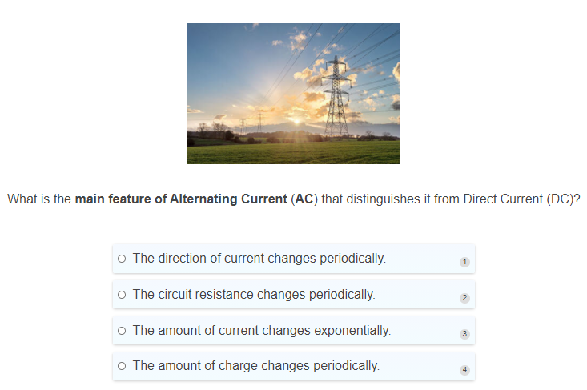

Slide 6
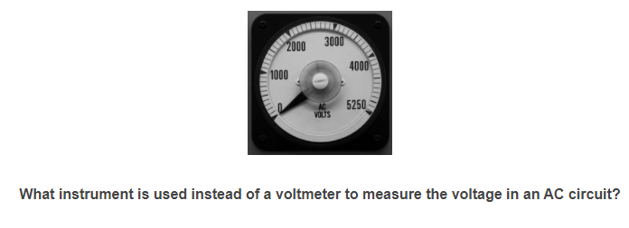

Slide 7
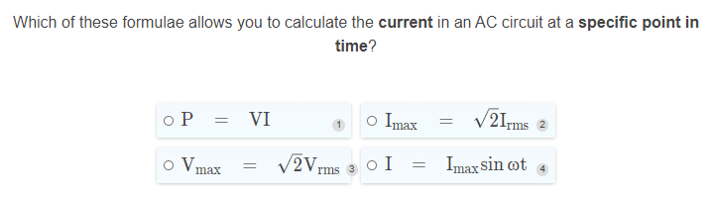

Slide 8
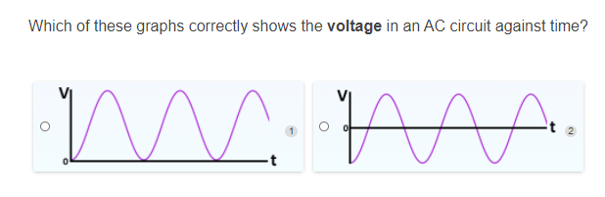

Slide 9
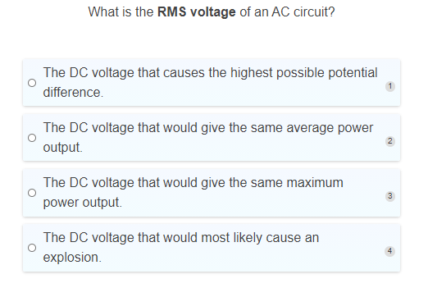

Slide 10
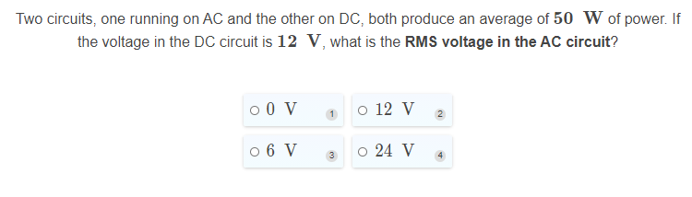

Slide 11
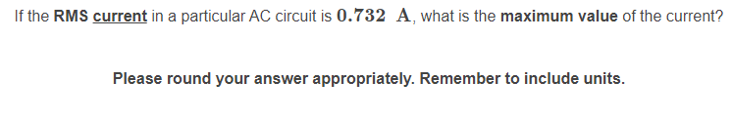

Slide 12
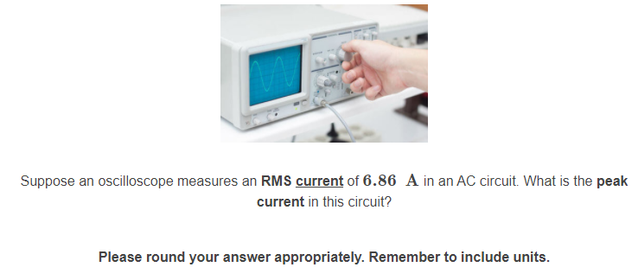

Slide 13
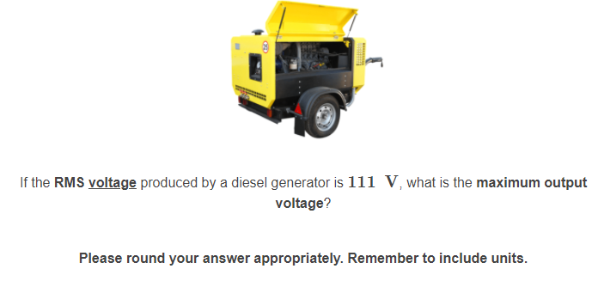

Slide 14
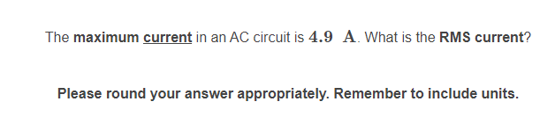

Slide 15
